Slide 1
江烈 2013-05-14
Hedwig架构及原理简介

Slide 2
讲师个人介绍
中文名：江烈
英文名：Archer
爱好：最近喜欢攀岩和特技风筝
SOA团队：
江烈 Hedwig owner
张晋 Jumper owner
徐从伟 Detector owner
陈长坚 Kira owner

Slide 3
课程目录
-Hedwig Origin
-Architecture Bird View
-Why Hedwig
-Key Features
-Future

Slide 4

Hedwig Origin

Slide 5
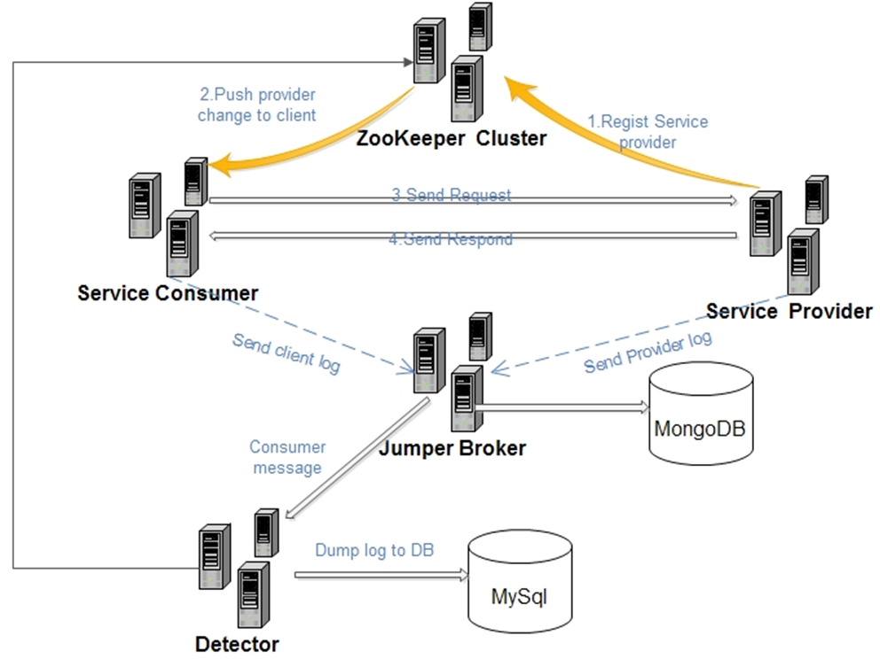
Bird View

Slide 6
Why Hedwig
Shared nothing Architecture.
Scalability, High-Availability, Reliability
Staged Event Drive Architecture.
Maintainability, Extensibility
Peer-to-Peer Communication
Performance, Decentralized
Publish-Subscribe
Maintainability, Manageability
Mimic biological systems
Self-regulation, Self-healing

Slide 7
Key Feature
Customized Protocol
Two phase Request & failover
Throttle client & server
Software load balance
Sharding / group
Service switcher (open/close )
Request life cycle monitor

Slide 8
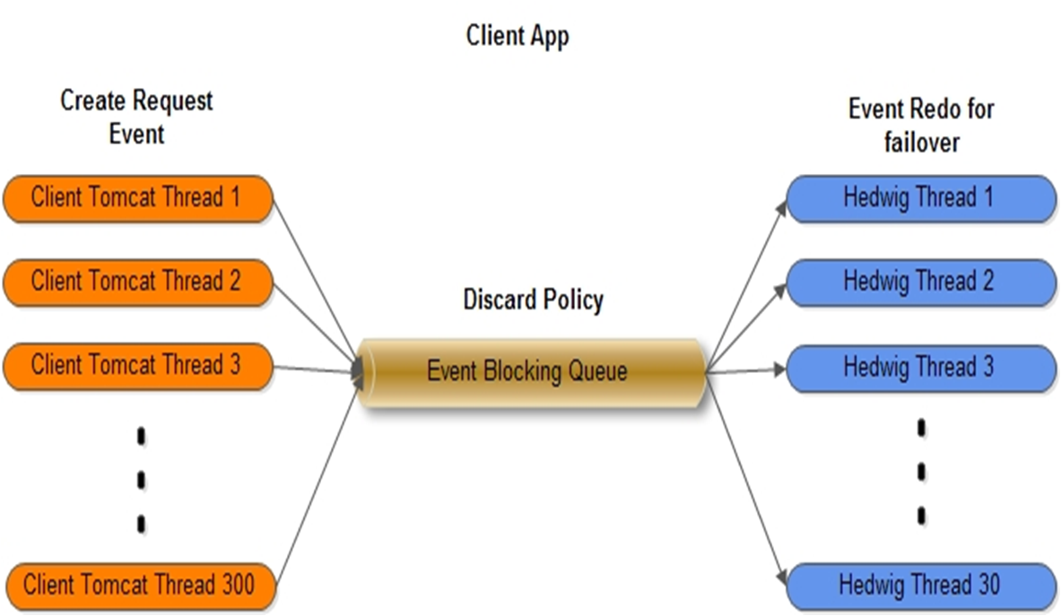
Two phase Request & failover
Hedwig Client Thread model

Slide 9
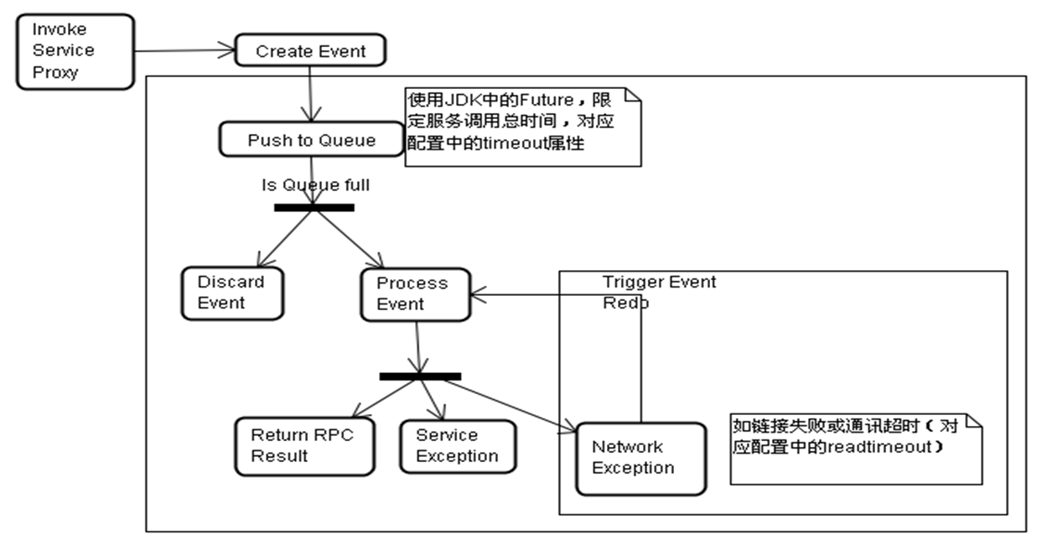
Request Process Flow

Slide 10
Software load balance
Round Robin Balancer
Weighted Round Robin Balancer
Consistent Hash Balancer

Slide 11
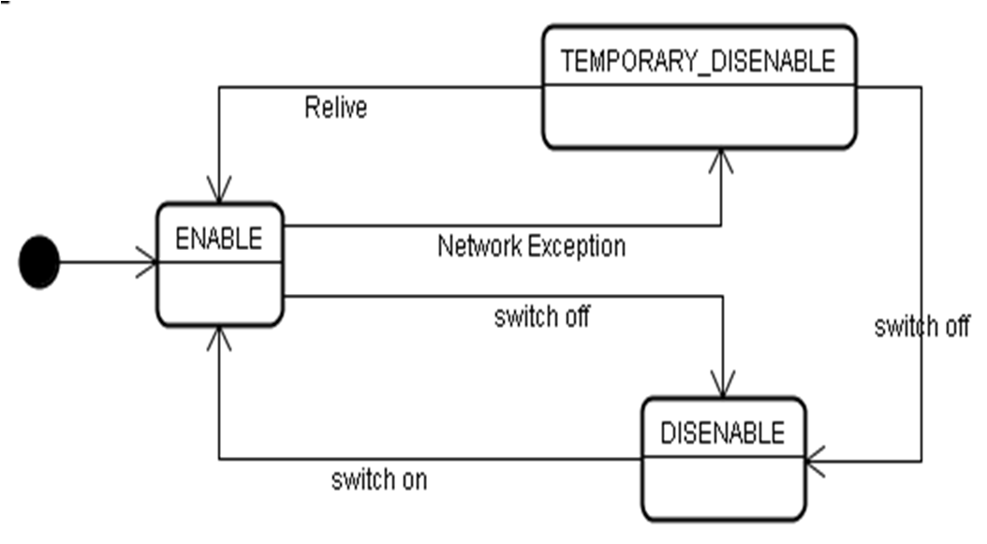
Service Node Status
com.yihaodian.architecture.hedwig.common.util.RelivePolicy
Hedwig 0.1.1-snapshot policy: invoke * node weighted/total weighted /10
Hedwig 0.1.2-snapshot policy: Can’t describe by a simple formula, threshold 100tps

Slide 12
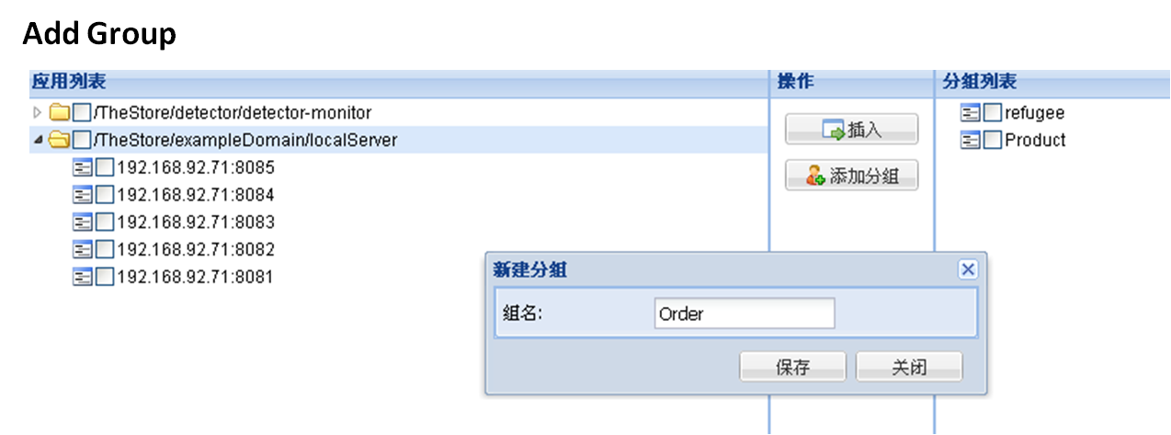
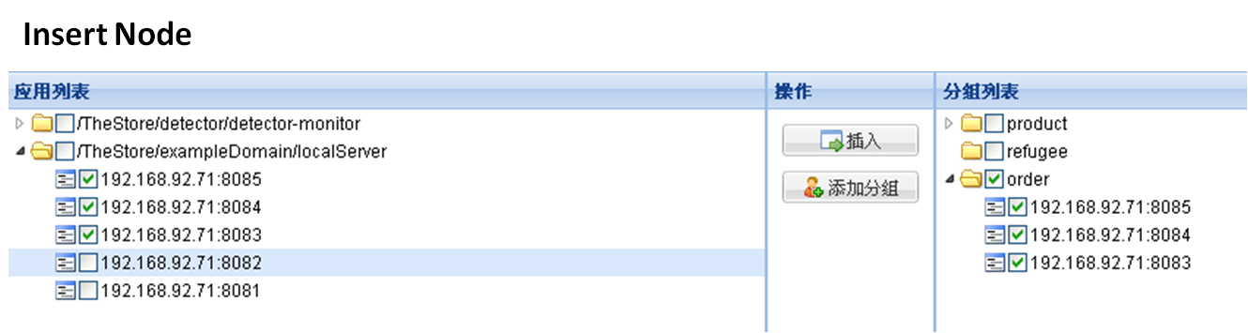
Sharding / group

Slide 13
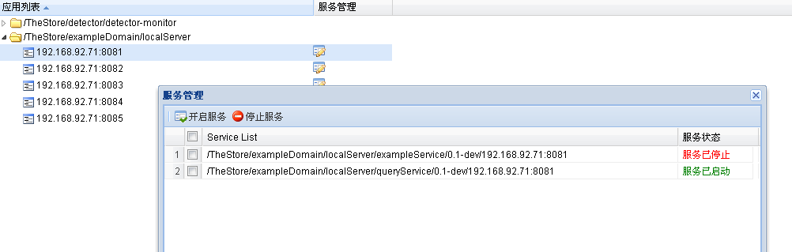
Service switcher

Slide 14
Request life cycle monitor

Slide 15
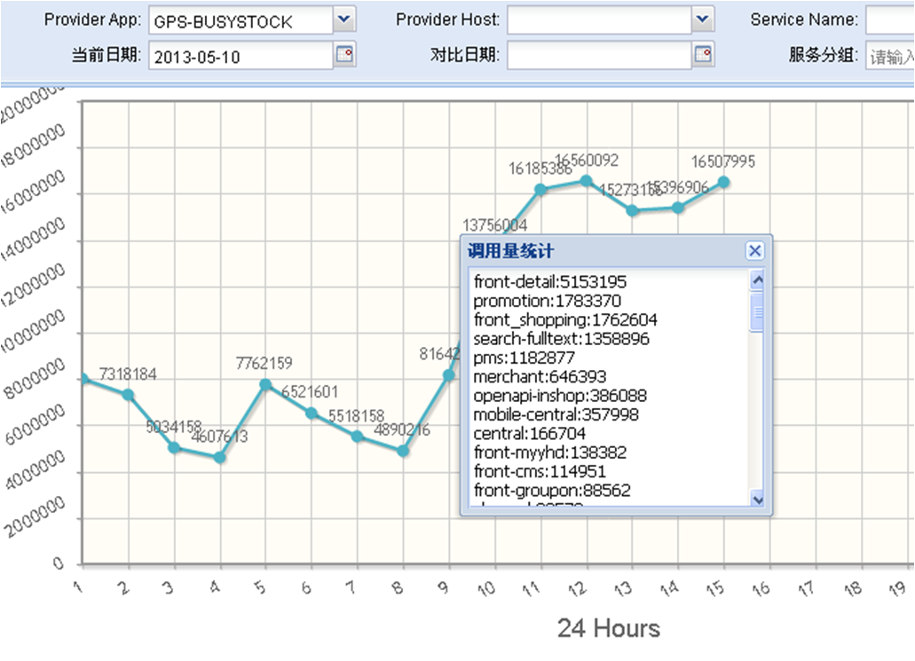
Request Count Monitor

Slide 16
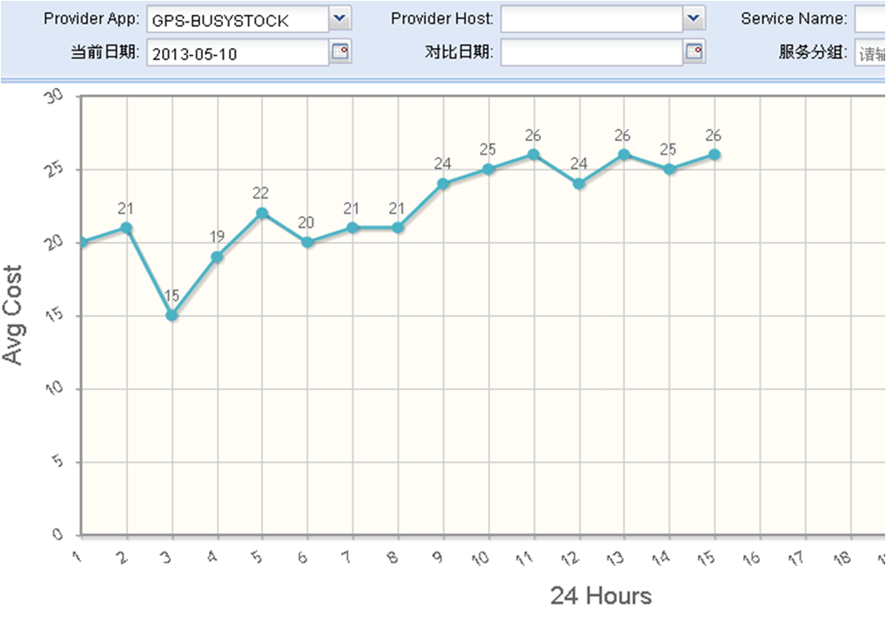
Average Response Time Monitor

Slide 17
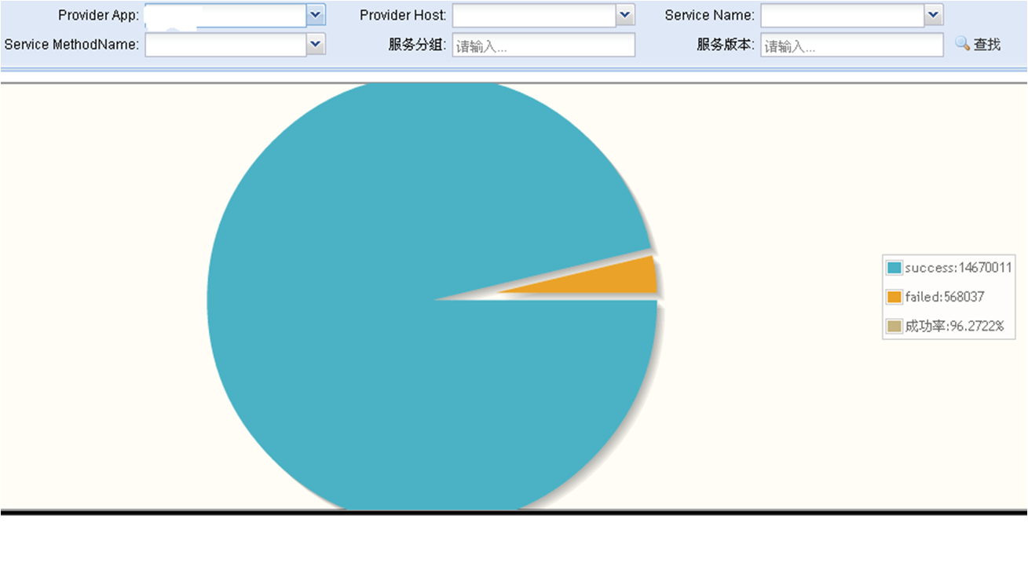
Success Rate Monitor

Slide 18
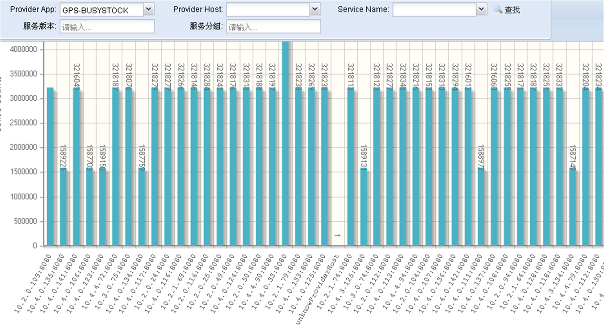
Load Balance Monitor

Slide 19
Future
Massive data storage
Hbase，Hadoop，Storm
Transport Layer Protocol
TCP，UDP，SCTP
From Alarm to Forecast
Capacity planning
Cross Language
Base64,Thrift,protobuf

Slide 20
Q&A

Slide 21
Recruitment
熟悉zookeeper、storm，mongo等分布式应用集群部署、开发和维护
熟悉至少一个开源项目的源码
熟悉zookeeper架构原理;
熟悉多线程编程技术;
熟悉jvm运行机制及内存管理
熟悉Linux操作系统，熟悉脚本编程；
熟悉OOD、OOP以及设计模式等基本设计方法，熟悉UML；
熟悉Web前端技术（jQuery,ext等开发框架任意一种）；

Slide 22
Thank You!

